Slide 1
Public Key Cryptography
Zaobo He

Slide 2
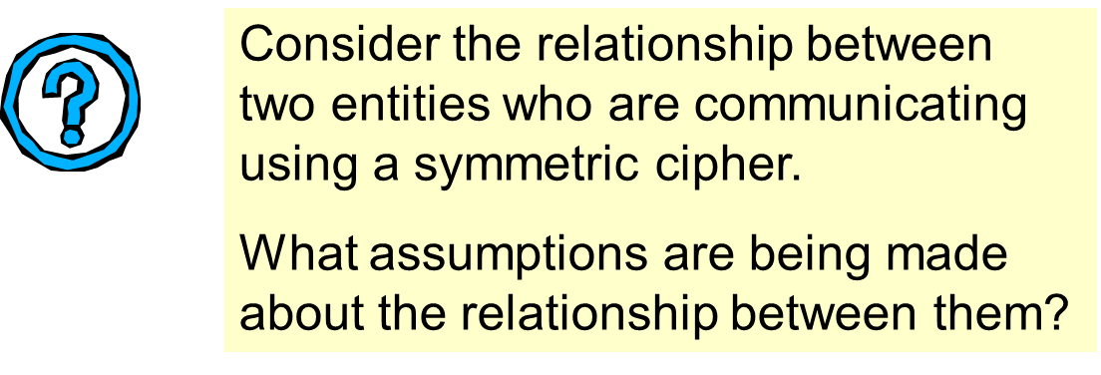
Symmetric Assumptions

Slide 3








Private Key
Private Key (Symmetric-key): Sender and receiver share a common (private) key
SK
SK

Slide 4
The briefcase example
The procedure of key-sharing
Alice
Bob
1
2
3
4
5
Notes:
1. The briefcase has to be sent back and forward three times, which seems pretty inefficient.

Slide 5
Private key cryptography revisited
Good: Quite efficient
Bad: Key distribution and management is a serious problem – for N users O(N²) keys are needed

Slide 6
Key management
Problem: Communicating among n users.
Total: O(n) keys per user
U₁
k_{1,2}
U₂
k_{1,4}
k_{3,2}
k_{4,2}
k_{1,3}
U₄
U₃
k_{4,3}
Notes:
Suppose we have n users. Then if all n users want to be able to securely communicate with all of the other users, each user will need to store n-1 keys so there will be a total of n*(n-1) keys stored!

Slide 7
One Solution: Trusted Third Party (TTP)
Everyone needs only one key
U₁
U₂
k_{1,TTP}
k_{2,TTP}
TTP
k_{4,TTP}
k_{3,TTP}
U₄
U₃
Notes:
One alternative, is for a Trusted Third Party to hold each person's private key. Then each user needs to keep only their own key until they want to communicate with another user.

Slide 8
Trusted Third Party (TTP)
Alice (k_{a})
Bob (k_{b})
TTP (k_{t})
1. “Alice wants to talk to Bob”
2. Choose random K_{AB}
using k_{a} to encrypt k_{ab}
3. E(k_{a}, K_{ab})
ticket = E(k_{b}, K_{ab})
using k_{b} to encrypt k_{ab}
4. K_{ab}=D(k_{a}, K_{ab})
5. E(K_{ab}, “Hi, Bob, this is Alice!”)
ticket = E(k_{b}, K_{ab})
using k_{ab} to encrypt “Hi, ….”
6. K_{ab}=D(k_{b}, K_{ab}) E(K_{ab} ,“Hi, Alice, this is Bob”)
Notes:
This is secure against eavesdropping but there are other attacks against this. One is the replay attack. For example, suppose Alice buys a book from merchant Bob and an eavesdropper records the session. The eavesdropper can, then, replay the exchange to Bob and, then, Alice will get another copy of the book - probably not a happy event

Slide 9
Security Analysis
Suppose (E,D) is secure (i.e., semantically secure).
Eve sees traffic, but learns nothing about k_{ab}
TTP needed to set up every session
TTP can decrypt everything
Alice (k_{a})
Bob (k_{b})
TTP
Eve Sees All Traffic

Slide 10
Key question
Can we generate shared keys without an online trusted 3rd party?
Answer: yes!

Slide 11
Public key blueprint
The keys used to encrypt and decrypt are different.
Anyone who wants to be a receiver needs to “publish” an encryption key, which is known as the public key.
Anyone who wants to be a receiver needs a unique decryption key, which is known as the private key.
It should not be possible to deduce the plaintext from knowledge of the ciphertext and the public key.
Notes:
1. Some guarantee needs to be offered of the authenticity of a public key.

Slide 12


Public Key
Public Key (Asymmetric Key): Every user has a private key and a public key
PubK
SK

Slide 13


Public Key Encryption
Two keys:
public encryption key e
private decryption key d
Part A
Part B
A’s private key
A’s public key
B’s public key
A’s private key
PR_{A}
PU_{A}
PU_{B}
PR_{B}
Encrypt with PR_{B}
Decrypt with PR_{B}

Slide 14
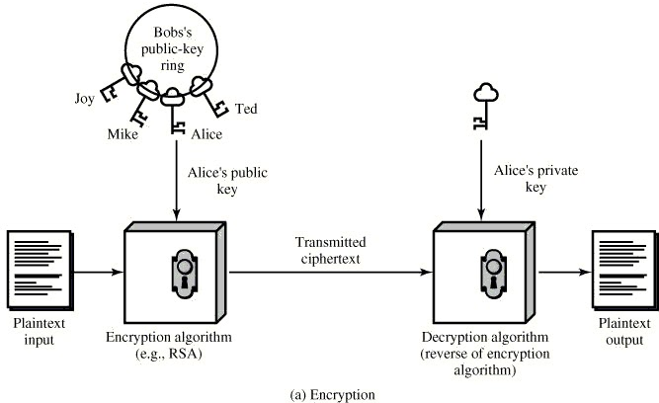
Public key cryptography model
Good: Key management problem potentially simpler
Bad: Much slower than private key crypto (we’ll see later!)

Slide 15
Design of a public key algorithm
In a public key system, if everyone knows everything necessary:
the encryption algorithm,
the encryption key (i.e., public key)
The ciphertext
then how is it possible that they cannot then work out what the plaintext (decryption key) is from this information?

Slide 16
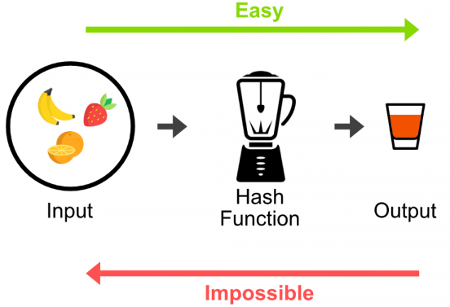
One Way Function
A one-way function is a function that is “easy” to compute and “difficult” to reverse.
How might we express this notion of a one way function informally in complexity theoretic terms?

Slide 17
Factoring Problem

Slide 18
Multiplying two primes is Easy
A number is prime if its only divisors are 1 and itself:
2,3,5,7,11,13,17,19, …
It is easy to take two prime numbers and multiply them together
If they are fairly small we can do this in our heads, on a piece of paper, or on a calculator
As they get bigger and bigger it is fairly easy to write a computer program to compute the product
Multiplication runs in polynomial time.

Slide 19
Multiplying two primes is Easy (Cont.)
It is easy to calculate multiplication pq = ?
Problem: n = pq (p and q are prime numbers)
2 × 3 = 6
5 × 11 = 55
89 × 97 = 8633

Slide 20
Find factors of large numbers is Hard
It is difficult to find factors of large numbers
Problem: n = pq (p and q are prime numbers)
6 = 2 × 3
55 = 5 × 11
8633 = 89 × 97
n has: | or: | it takes
300 bits | 100 digits | hours
600 bits | 200 digits | months
1024 bits | 300 digits | currently not possible
2048 bits | 600 digits | currently not possible

Slide 21
Multiplying two primes: one-way function
Multiplication of two prime numbers is believed to be a one-way function.
We say believed because nobody has been able to prove that it is hard to factorise.
Maybe one day someone will find a way of factorising efficiently.
What will happen if someone does find an efficient way of factorising ?

Slide 22
RSA

Slide 23
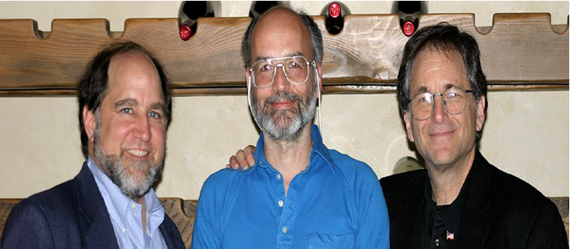
RSA Algorithm - Introduction
by Rivest, Shamir & Adleman of MIT in 1977
best known & widely used public-key scheme
Notes:
The RSA public key encryption algorithm was the first practical implementation of public key encryption discovered.
It remains the most used public key encryption algorithm today.

Slide 24
RSA Algorithm – Introduction (cont.)
RSA is the first and most popular asymmetric encryption
Idea behind RSA:
Every number has a prime factorization
It is hard to find if the number is very large
The time complexity is also very high
But on the other hand the multiplication is easy and time complexity is also not very high
For example the multiplication of 15 and 30 is 450
but the prime factorization of 450 is not easy and also it takes more time as compared to multiplication
One direction is easy; The other direction is difficult!

Slide 25
Rationale Behind RSA: Algorithm
Each user generates a public/private key pair by:
Selecting two different large primes at random: p and q
Compute their system modulus: n = pq
Calculate the totient: φ(n) = (p - 1)(q - 1)
Choose an integer e such that:
1 < e < φ(n)
e is coprime to φ(n)
i.e., e and φ(n) share no factors other than 1
{e, n} are released as the public key

Slide 26
RSA Encryption
Encryption: m^{e} mod n = c
Secret message: m
Encrypted text: c
Public key: e, n
The key for encryption is publicly known

Slide 27
RSA Decryption
Decryption uses the private key d
c^{d} mod n = m

Slide 28
Rationale Behind RSA: Algorithm (cont.)
Solve following equation to find decryption key d:
d*e = 1 mod φ(n)
i.e., d*e = 1 - k*φ(n) for some integer k
i.e., $d=\frac{1 − kφ(n)}{e}$
{d} is the private key

Slide 29
Examples (Bob sends message to Alice)
Given:
Alice want to receive message m from Bob
Bob with message: m, m = 89
Charlie: eavesdropper

Slide 30
Example: Procedure of Alice
RSA algorithm: (work in party Alice)
choose prime p and q: p = 53, q = 59
compute n: n = pq = 53*59 = 3127
calculate the totient: φ(n) = (p - 1)(q - 1)= (53-1)(59-1) = 3016
choose an integer e: e = 3
{e, n} = {3, 3127} are released as the public key

Slide 31
Example: Procedure of Charlie
RSA algorithm: (work in Charlie)
Obtain public key n and e

Slide 32
Example: Procedure of Bob
RSA algorithm: (work in Bob)
Obtain public key n and e
Encrypt m: m^{e} mod n = c
Here: c = (89³) mod 3127 = 1394
Transmit c to Alice

Slide 33
Example: Procedure of Charlie
Intercept encrypted message c = 1394 (work in Charlie)
Charlie try to decrypt encrypted message with n, e, c
But failed! Why?
As long as it is not possible to discover p and q with n = pq, it is not possible to find d or to decrypt m

Slide 34
Example: Procedure of Alice
RSA algorithm: (work in Alice)
Obtain encrypted message c = 1394
Compute private key d
suppose k = -2 (any integer is ok)
$$d=\frac{1−kφ(n)}{e}=\frac{1−(−2)×3016}{3}=2011$$
Decrypt c and get m by computing (c^{d}) mod n = m
(1394²⁰¹¹) mod 3127 = 89
Done!

Slide 35
Another Example (a little different in choosing e and d)
RSA algorithm: (work in party Alice)
choose prime p and q: p = 3, q = 11
compute n: n = pq = 3 × 11 = 33
calculate the totient: φ(n) = (p - 1)(q - 1)= (3 - 1)(11 - 1) = 20
according: d*e = 1 - k*φ(n) for some integer k
d*e = 1 - k*φ(n) = 1 – (-1) × 20 = 21 (suppose k = -1)
choose: an integer e: e = 3 (because e is coprime to φ(n) ), then d = 7
{e, n} are released as the public key

Slide 36
Setting up RSA: example 3
Step 1: Let p = 47 and q = 59. Thus n = 47 x 59 = 2773
Step 2: Select e = 17
Step 3: Publish (n,e) = (2773, 17)
Step 4: (p-1) x (q-1) = 46 x 58 = 2668
Use the Euclidean Algorithm to compute the modular inverse of 17 modulo 2668. The result is d = 157
<< Check: 17 x 157 = 2669 = 1(mod 2668) >>
Public key is (2773,17)
Private key is 157

Slide 37
Encryption and decryption: example 3
Public key is (2773,17)
Private key is 157
Plaintext block represented as a number: M = 31
Encryption using Public Key: C = 31¹⁷ (mod 2773)
= 587
Decryption using Private Key: M = 587¹⁵⁷ (mod 2773)
= 31

Slide 38
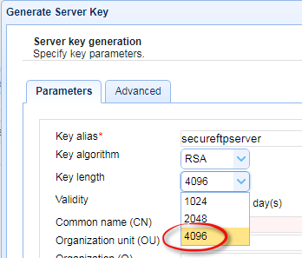
Breaking RSA Encryption
As long as there is no fast solution for finding
n = pq
RSA encryption is safe
The theoretical basis of RSA: Factoring Problem
RSA-2048 (key length: 2048 bits)
Estimated Breakdown Time：
300 trillion years （300 万亿年）
cosmic age: 138 trillion years

Slide 39
Discrete Logarithm Problem

Slide 40
Modular exponentiation
Raising a to the power b, normally denoted a^{b} just means multiplying a by itself b times. In other words:
a^{b} = a x a x a x … x a
Modular exponentiation means computing a^{b} modulo some other number n. We tend to write this as
a^{b} mod n.
Modular exponentiation is “easy”.

Slide 41
Modular exponentiation (Cont.)
Given m^{e} mod n = c
Problem: m, e, n are known. c is unknown
Easy!

Slide 42







Modular exponentiation (Cont.)
Given m^{e} mod n = c
Problem: m, n, c are known. e is unknown
Difficult!
$$c$$
$$c +n$$
Hard
$$(n, m,c)$$
$$m^{e}$$
$$c +2n$$
$$……$$
$$c +kn$$

Slide 43
Modular exponentiation (Cont.)
This difficult problem is often referred to as the discrete logarithm problem.
In other words, given a number a and a prime number n, the function
f(b) = a^{b} mod n
is believed to be a one-way function.

Slide 44
ElGamal

Slide 45
ElGamal
The ElGamal encryption algorithm is an asymmetric encryption algorithm based on Diffie-Hellman key (DH) exchange proposed by Tather ElGamal in 1985.
It is an encryption system based on the discrete logarithm problem.

Slide 46











ElGamal – Key generation
To generate his private key and his public key Bob does the following.
choose: $p$, $g$
(Large primes)
$$p=139, g=3$$
choose: $x$
(Random numbers)
$$x=12$$
compute: $y$
$$y=g^{x} mod p$$
$$y=3^{12} mod 139=44$$
generate a public key:
$$(p, g,y)$$
$$(139, 3,44)$$
generate a private key:
$$x$$
$$x=12$$

Slide 47










ElGamal – Encryption
To encrypt a message, Alice does the following
$$(p, g,y)$$
Public key of Bob:
$$(139, 3,44)$$
message: $m$
(The message to be encrypted)
choose: $k$
Random number
compute the ciphertext: $C_{1}$
$$C_{1}=g^{k} mod p$$
compute the ciphertext: $C_{2}$
$$C_{2}=m∗y^{k} mod p$$
Ciphertext:
$$(C_{1},C_{2})$$
𝒎 = 100
$C_{1}=g^{k} mod p=3^{52}mod 139=38$
k = 52
$$C_{2}=m∗y^{k} mod p=100∗{44}^{52} mod 139=80$$
$$\left(C_{1},C_{2}\right)=(38,80)$$

Slide 48


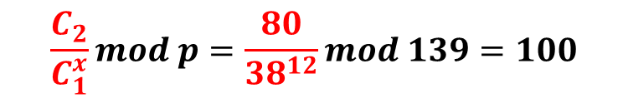

ElGamal – Decryption
To decrypt a message, Bob does the following
$$x=12$$
$$\left(C_{1},C_{2}\right)=(38,80)$$
Private key of Bob:
Plaintext = $C_{2}/C_{1}^{x} mod p$
$$\frac{C_{2}}{C_{1}^{x}}mod p=\frac{80}{{38}^{12}}mod 139=100$$
http://rangerway.com/way/public-key-one-elgamal

Slide 49




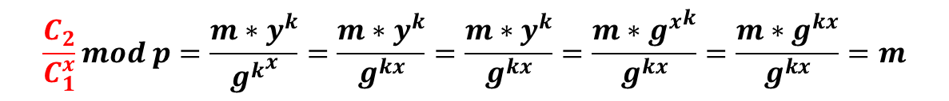
ElGamal
$$C_{1}=g^{k} mod p$$
$$y=g^{x} mod p$$
$$C_{2}=m∗y^{k} mod p$$
Plaintext = $C_{2}/C_{1}^{x} mod p$
$$\frac{C_{2}}{C_{1}^{x}}mod p=\frac{m∗y^{k}}{{g^{k}}^{x}}=\frac{m∗y^{k}}{g^{kx}}=\frac{m∗y^{k}}{g^{kx}}=\frac{m∗{g^{x}}^{k}}{g^{kx}}=\frac{m∗g^{kx}}{g^{kx}}=m$$

Slide 50

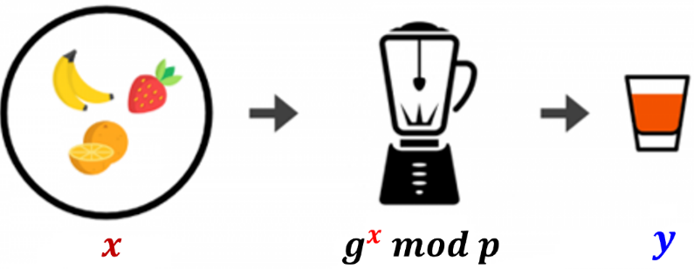













Security analysis of ElGamal
?
Public key:
$$(p, g,y)$$
$$y=g^{x} mod p$$
$$x$$
Theoretical Foundations of ElGamal: Discrete Logarithm Problem
Private key:
$$x$$
easy
$\left(p, g\right),$ $x$
$$y=g^{x} mod p$$
$$y$$
$$y +p$$
难
$$(p, g,y)$$
$$g^{x}$$
$$y +2p$$
One-way function: "Easy" calculation and "difficult" reversal
$$……$$
$$y +np$$

Slide 51
One of the Applications of RSA:
Homomorphic Encryption

Slide 52
Introduction to Homomorphic Encryption
Now the only thing anyone did with encrypted data was:
Decrypt it!
What else can we do with encrypted data, anyway?

Slide 53


What else can we do with encrypted data?
x
Query
Function f
x
search query
f(x)
Search results
Google server
WANT PRIVACY!

Slide 54
Homomorphic Encryption: The Objective
Delegate processing of data without giving away access to it

Slide 55


Computing on Encrypted Data
Enc(x)
x
Function f
Enc(f(x))
You: encrypt the query (e.g., x), send to Google
(Google does not know the key, cannot “see the x”)
Google: return encrypted query results (e.g., f(x)) to you
(You decrypted and recover the search results)

Slide 56
Computing on Encrypted Data (cont.)
Homomorphic encryption
Perform operations on plaintexts while manipulating only ciphertexts.
Normally, this seems not possible:
E_{k}(m₁) = 0x3c7317c6bc5634a4ad8479c64714f4f8
E_{k}(m₂) = 0x7619884e1961b051be1aa407da6cac2c
E_{k}(m₁ $⊕$ m₂) = ?
= ox25C…………………………………………..7AE
D_{k}(ox25C…………………………………………..7AE)
= m₁ $⊕$ m₂

Slide 57
Computing on Encrypted Data (cont.)
Normally, this seems not possible:
E_{k}(m₁) = 0x3c7317c6bc5634a4ad8479c64714f4f8
E_{k}(m₂) = 0x7619884e1961b051be1aa407da6cac2c
E_{k}(m₁ $⊕$ m₂) = ?
For some cryptosystems with algebraic structure, this is possible!

Slide 58
Homomorphic Encryption with RSA
Multiplicative property of RSA:
$$E\left(m1\right)=c1= m_{1}^{e} mod n$$
$$E\left(m2\right)=c2= m_{2}^{e} mod n$$
Given c₁ and c₂, we can compute the ciphertext c for plaintext $m1∙m2$
Using only the public-key
Without knowing the plaintexts m₁ and m₂
$E\left(m1∙m2\right)={(m1∙m2)}^{e} mod n$ = $c1∙c2$ = $E\left(m1\right)∙E\left(m2\right)$

Slide 59
Multiplicative Homomorphism
Multiplicative Homomorphism
$E\left(m1\right)$ × $E\left(m2\right)$ = $E\left(m1 × m2\right)$
RSA is one type of multiplicative homomorphism
See the example of homomorphic encryption with RSA

Slide 60
Practical Example
Imagine:
What’s the area?
Width = 7
Height = 3

Slide 61

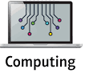
Practical Example (cont.)
Resort to Clouding Computing with plaintext:
What’s the area?
Width = 7
Height = 3
Privacy is threatened!

Slide 62


RSA to the Rescue
Select: p = 11, q = 13
Calculate n: n = pq = 143
Calculate totient: φ(n) = (p - 1)(q - 1)= (11 - 1)(13 - 1) = 120
Select e with condition gcd(e, 120) =1: e = 23
Public key: (23, 143)
d*e = 1 - k*φ(n) = 1 – (-9) × 120 = 1081, suppose k = -9, then;
$$d=\frac{1−kφ(n)}{e}=\frac{1−(−9)×120}{23}=47$$
Private key: (47, 143)

Slide 63
RSA to the Rescue (cont.)
Encrypt
Width = 7
Height = 3
Public key = (23, 143)
Private key = (47, 143)
c_{w} = width^{e} mod n
= 7²³ mod 143
= 2
c_{h} = height^{e} mod n
= 3²³ mod 143
= 126
Ciphertext:
Width = 2
Height = 126

Slide 64
RSA to the Rescue (cont.)
Resort to Clouding Computing with ciphertext:
What’s the area?
Ciphertext:
Width = 2
Height = 126
area = 252
Privacy is protected !

Slide 65
RSA to the Rescue (cont.)
Plaintext:
area = decrypt(252) = 21
area = cipher^{d} mod n
= 252⁴⁷ mod 143
= 21
Width = 7
Height = 3
$E\left(m1\right)$ × $E\left(m2\right)$ = $E\left(m1 × m2\right)$
Decrypt
Encrypt
What’s the area?
Ciphertext:
Width = 2
Height = 126
Cloud computing on ciphertext
area = 252

Slide 66
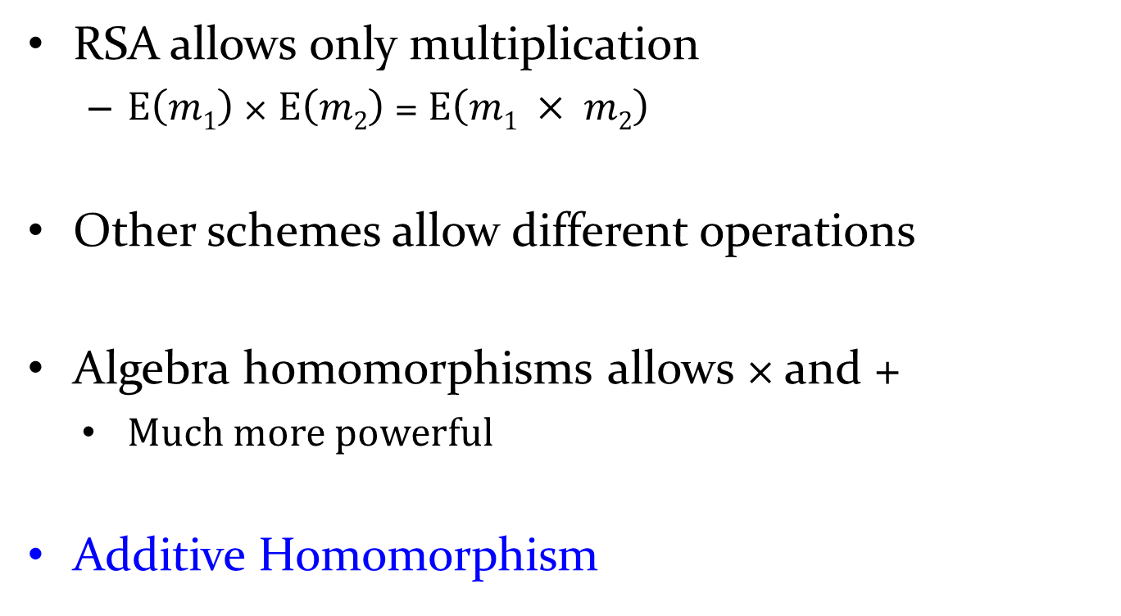
Additive Homomorphism
RSA allows only multiplication
$E\left(m1\right)$ × $E\left(m2\right)$ = $E\left(m1 × m2\right)$
Other schemes allow different operations
Algebra homomorphisms allows × and +
Much more powerful
Additive Homomorphism

Slide 67
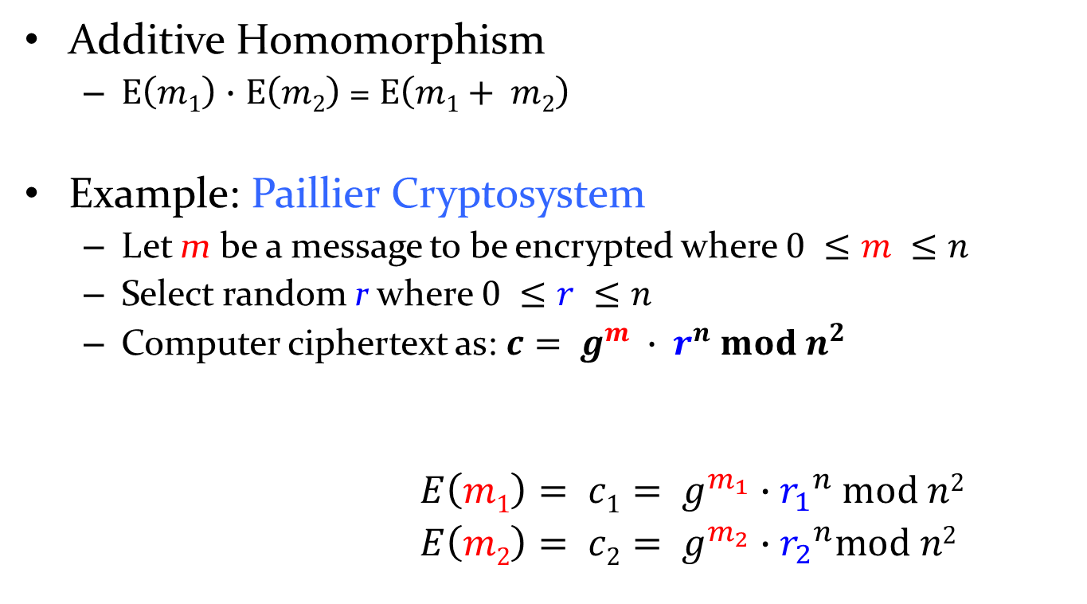
Additively Homomorphism: Paillier
Additive Homomorphism
$E\left(m1\right)$ $∙$ $E\left(m2\right)$ = $E\left(m1+ m2\right)$
Example: Paillier Cryptosystem
Let m be a message to be encrypted where $0 ≤m ≤n$
Select random r where $0 ≤r ≤n$
Computer ciphertext as: $c= g^{m} ∙ r^{n} mod n^{2}$
$E\left(m1\right)= c1= g^{m_{1}}∙{r_{1}}^{n} mod n2$
$E\left(m2\right)= c2= g^{m_{2}}∙{r_{2}}^{n}mod n2$

Slide 68
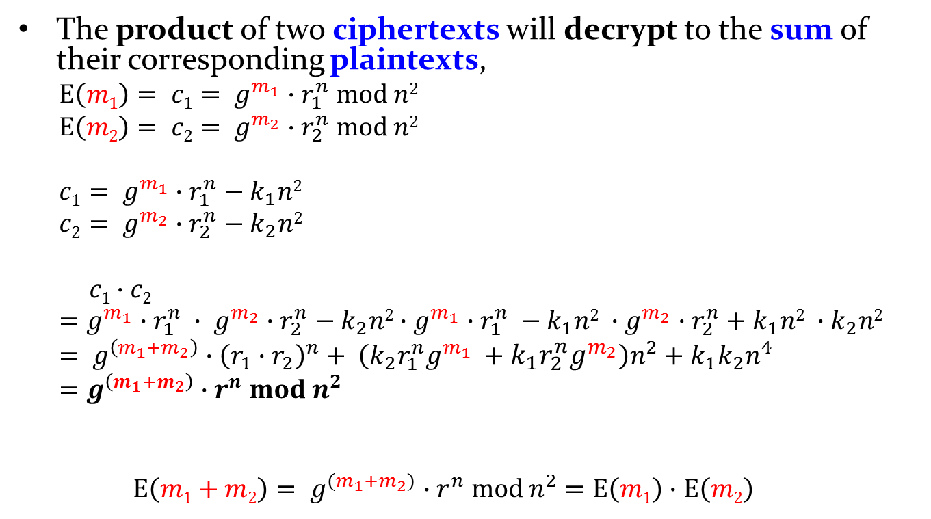
Additively Homomorphism: Paillier (cont.)
The product of two ciphertexts will decrypt to the sum of their corresponding plaintexts,
$E\left(m1\right)= c1= g^{m_{1}}∙r_{1}^{n} mod n2$
$E\left(m2\right)= c2= g^{m_{2}}∙r_{2}^{n} mod n2$
$$c1= g^{m_{1}}∙r_{1}^{n}−k_{1}n2$$
$$c2= g^{m_{2}}∙r_{2}^{n}−k_{2}n2$$
$$c1∙c2=g^{m_{1}}∙r_{1}^{n} ∙ g^{m_{2}}∙r_{2}^{n}−k_{2}n2∙g^{m_{1}}∙r_{1}^{n} −k_{1}n2 ∙g^{m_{2}}∙r_{2}^{n}+k_{1}n2 ∙k_{2}n2= g^{\left(m_{1}+m_{2}\right)}∙{\left(r_{1}∙r_{2}\right)}^{n}+ \left(k_{2}r_{1}^{n}g^{m_{1}} +k_{1}r_{2}^{n}g^{m_{2}}\right)n^{2}+k_{1}k_{2}n^{4}$$
$$=g^{\left(m_{1}+m_{2}\right)}∙r^{n} mod n^{2}$$
$E\left(m1+m2\right)= g^{(m_{1}+m_{2})}∙r^{n} mod n^{2}=E\left(m1\right)$ $∙$ $E\left(m2\right)$

Slide 69
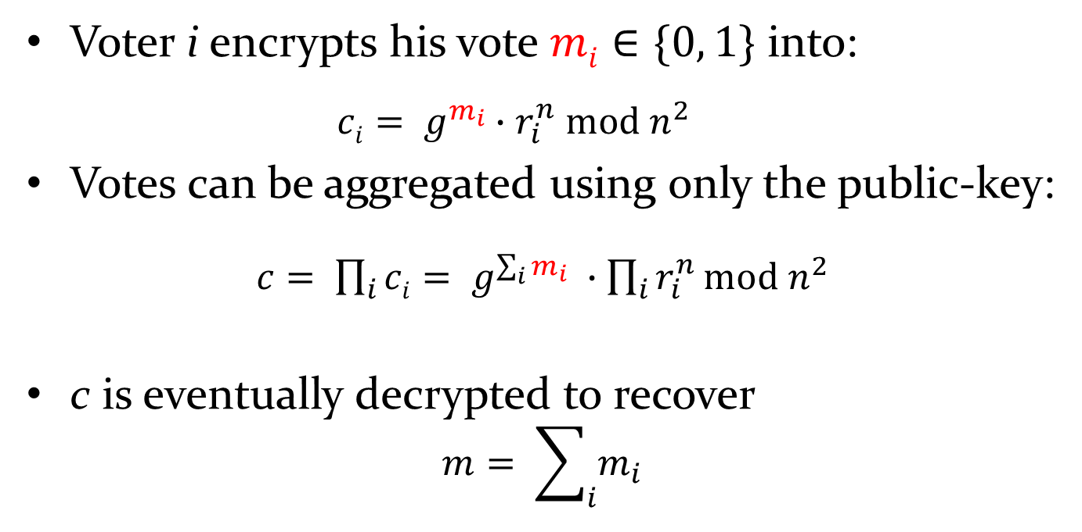
Application: e-voting
Voter i encrypts his vote $mi∈\{0, 1\}$ into:
$$ci= g^{m_{i}}∙r_{i}^{n} mod n^{2}$$
Votes can be aggregated using only the public-key:
$c= \prod_{i}{ci}= g^{\sum_{i}{m_{i}}} ∙\prod_{i}{r_{i}^{n}}mod n^{2}$
c is eventually decrypted to recover
$$m= \sum_{i}{m_{i}}$$

Slide 70
Forward secrecy
Perfect Forward Secrecy, also called forward secrecy
Refers to an encryption system that changes the keys used to encrypt and decrypt information frequently and automatically
Ensures that even if the most recent key is hacked, a minimal amount of sensitive data is exposed
Web pages, calling apps, and messaging apps all use encryption tools with perfect forward secrecy that switch their keys as often as each call or message in a conversation, or every reload of an encrypted web page. This way, the loss or theft of one decryption key does not compromise any additional sensitive information—including additional keys.
Whether RSA and El Gamal satisfy forward secrecy?
Notes:
Web pages, calling apps, and messaging apps all use encryption tools with perfect forward secrecy that switch their keys as often as each call or message in a conversation, or every reload of an encrypted web page. This way, the loss or theft of one decryption key does not compromise any additional sensitive information—including additional keys.

Slide 71
Diffie-Hellman key agreement protocol

Slide 72
Diffie-Hellman Key Exchange
The question of key exchange was one of the first problems addressed by a cryptographic protocol. This was prior to the invention of public key cryptography
The Diffie-Hellman key agreement protocol (1976) was the first practical method for establishing a shared secret over an unsecured communication channel.
The point is to agree on a key that two parties can use for a symmetric encryption, in such a way that an eavesdropper cannot obtain the key

Slide 73
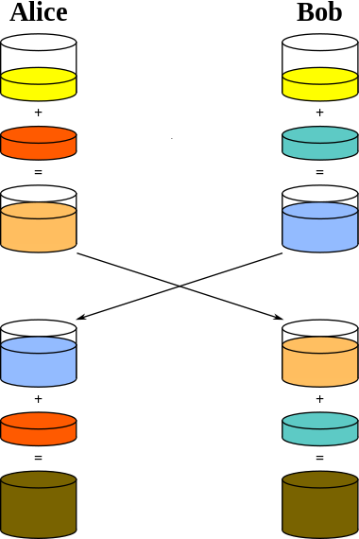
Diffie-Hellman Key Exchange Protocol
A
B
Objective: A and B share a secret key
Public pigments
easy
hard
Private pigments
Can A and B infer each other’s private pigments successfully?
Mixed pigments
exchange
Private pigments
By eavesdropping, can the attacker infer the private pigments of A or B?
Shared pigments

Slide 74









Diffie-Hellman Key Exchange Protocol
Objective: A and B share a secret key
A
B
Public pigments
A and B share：big primes：$p$ and $g$
choose private key (random number):
A：$a<p$；B：$b<p$
$$a$$
$$b$$
Private pigments
Compute public key：A： A = gª mod p
Mixed pigments
A
B
exchange
B： B = g^{b} mod p
After exchange：
A get： B = g^{b} mod p
B
A
B get： A = gª mod p
$$a$$
Private pigments
$$b$$
A computes the shared key
$$s$$
$$s$$
s = Bª mod p
= ${{(g}^{b})}^{a} mod p$
Shared pigments
B computes the shared key
s = A^{b} mod p
= ${{(g}^{a})}^{b} mod p$

Slide 75


Diffie-Hellman Key Exchange Protocol
A
B
Security analysis: Can an attacker get the shared secret key?
Public pigments
$$a$$
$$b$$
Private pigments
Eavesdropping: A and B
Mixed pigments
A
B
Infer：$a$，$b$
exchange
Shared secret key: $s$
？
B
A
$$a$$
Private pigments
$$b$$
A computes the shared key
$$s$$
$$s$$
s = Bª mod p
= ${{(g}^{b})}^{a} mod p$
Shared pigments
B computes the shared key
s = A^{b} mod p
= ${{(g}^{a})}^{b} mod p$
8/21

Slide 76












Diffie-Hellman Key Exchange Protocol
Eavesdropping: A and B
Compute public key：A： A = gª mod p
Infer：$a$，$b$
B： B = g^{b} mod p
Shared secret key: $s$
？
easy
$\left(p, g\right),$ $a$
$$\text{A}\text{ = }g^{a} \text{mod} \text{p}$$
$$A$$
difficult
$$A +p$$
$$(p, g,A)$$
$$g^{a}$$
$$A +2p$$
$$……$$
$$A +np$$
One-way functions: "Easy" calculation and "difficult" reversal
Theoretical foundations of the Diffie-Hellman key exchange protocol:
the discrete logarithmic problem

Slide 77




Man-in-the-middle attacks
Man-in-the-middle attacks：
Request a message
×
By intercepting normal network traffic Tampering with the content of communications Both sides of normal communication were unaware of the attack
Response packets
2. Intercept the response
user
server
1. Monitoring, interception
Response packets
Request a message
4.
Masquerading as a user
3.
Masquerading as a server
FoxAcid server
APT-C-40
Quantum Attack Platform (NSA):
Can the Diffie-Hellman protocol resist man-in-the-middle attacks?

Slide 78


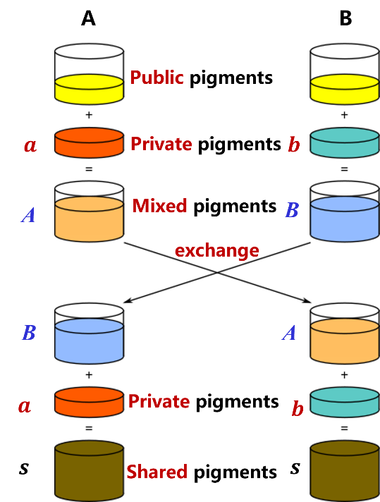











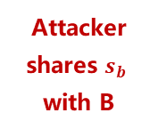

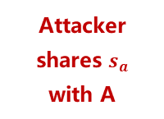





Diffie-Hellman protocol security—man-in-the-middle attacks
A
B
$$a$$
$$A=g^{a} mod p$$
intercept
$$b$$
$$B=g^{b} mod p$$
$$x$$
$$M=g^{x} mod p$$
forge
$$M=g^{x} mod p$$
$$s_{a}=Ma mod p$$
$$s_{a}$$
Attacker shares $s_{a}$ with A
$$={{(g}^{x})}^{a} mod p$$
$$s_{b}$$
$$s_{b}=Mb mod p$$
$$={{(g}^{a})}^{x} mod p$$
Attacker shares $s_{b}$ with B
$$={{(g}^{x})}^{b} mod p$$
$$=A^{x} mod p$$
$$={{(g}^{b})}^{x} mod p$$
$$=B^{x} mod p$$
The Diffie-Hellman protocol is not resistant to man-in-the-middle attacks

Slide 79






Quiz
Is there a way to make the DH protocol resistant to man-in-the-middle attacks?
A
B
$$A=g^{a} mod p$$
Intercept
$$B=g^{b} mod p$$
Forge
$$M=g^{x} mod p$$
Compute
$$s_{a}$$
$$s_{b}$$
Digital signature: authenticity of the source, untampered with the message, non-repudiation of the sender
Based on digital signature technology, the DH protocol is modified to make it resistant to man-in-the-middle attacks

